Slide 1
Constraint Removal Solutions

Slide 2
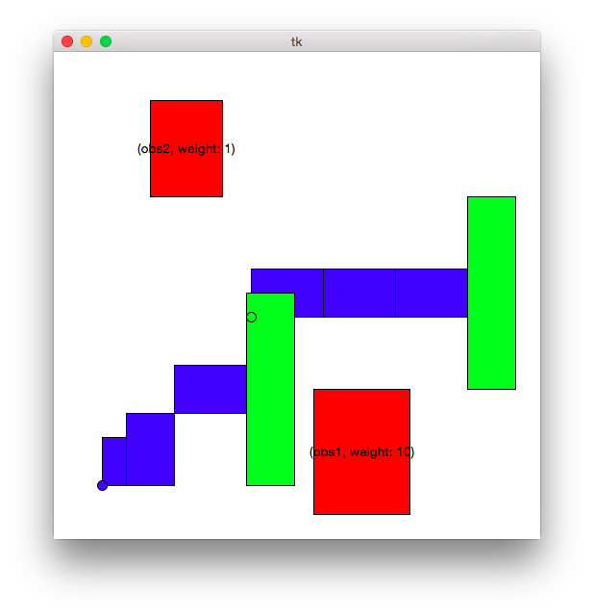
Simple Feasible world (200 iter, 200 trials, 40 interval)
algorithm | success rate | avg fail time | avg success time | avg path length | avg cover score
RRT | 19 | 3.948243834 | 2.48 | 5561.92 | 0
BiRRT | 100 | 0 | 0.96 | 5432.94 | 0
TLP MCR | 100 | 0 | 0.98 | 5302.77 | 0
Greedy Removal | 100 | 0 | 0.79 | 5116.33 | 1.41
Probabilistic Removal | 100 | 0 | 0.83 | 5099.30 | 2.75
Ignore Non-Permanent | 100 | 0 | 0.54 | 4710.94 | 10.18
Repeat Prob Removal | 100 | 0 | 7.77 | 4653.65 | 0
Search Then Greedy Removal | 100 | 0 | 1.35 | 5570.78 | 0.05
HPN Like Removal | 100 | 0 | 1.21 | 5388.80 | 0

Slide 3
Takeaway

Slide 4
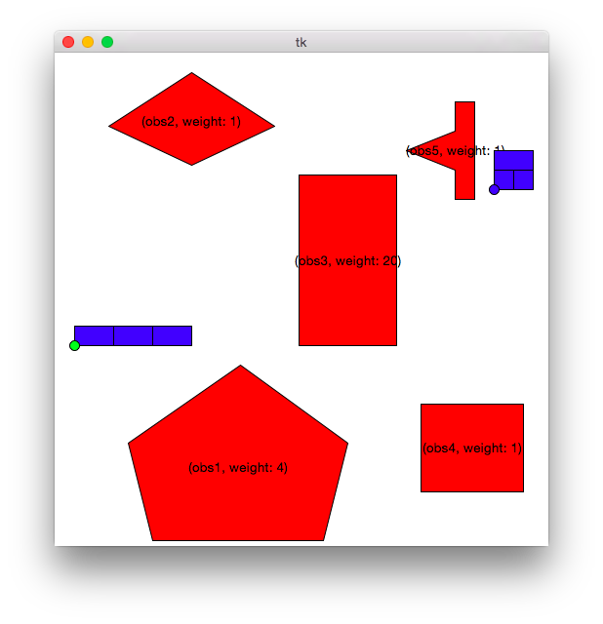
Complicated Feasible World (200 iter, 200 trials, 40 interval)
algorithm | success rate | avg fail time | avg success time | avg path length | avg cover score
RRT | 3 | 2.76 | 2.28 | 7795.35 | 0
BiRRT | 52 | 9.75 | 4.75 | 8676.26 | 0
TLP MCR | 68.5 | 10.49 | 5.46 | 8762.12 | 0
Greedy Removal | 100 | 0 | 2.94 | 9048.46 | 6.34
Probabilistic Removal | 100 | 0 | 2.53 | 8693.80 | 11.54
Ignore Non-Permanent | 100 | 0 | 0.91 | 6477.88 | 22.78
Repeat Prob Removal | 100 | 0 | 25.11 | 8653.24 | 1.28
Search Then Greedy Removal | 100 | 0 | 4.29 | 9196.23 | 2.53
HPN Like Removal | 100 | 0 | 8.36 | 9471.13 | 0.56

Slide 5
Takeaway

Slide 6
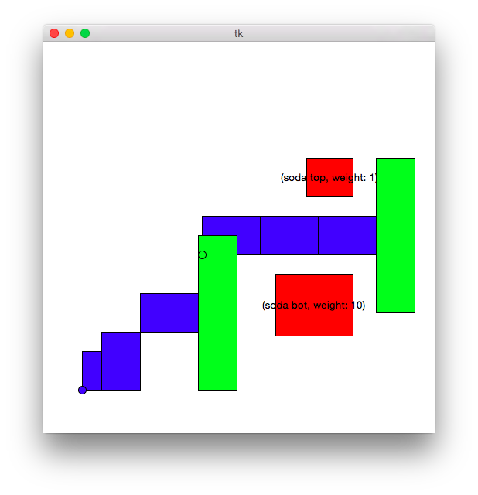
Simple Unfeasible world (200 iter, 200 trials, 40 interval)
algorithm | success rate | avg fail time | avg success time | avg path length | avg cover score
RRT | 0 | 0.83 | 0 | 0 | 0
BiRRT | 0 | 4.31 | 0 | 0 | 0
TLP MCR | 0 | 4.26 | 0 | 0 | 0
Greedy Removal | 100 | 0 | 1.40 | 5151.30 | 2
Probabilistic Removal | 100 | 0 | 1.36 | 5076.79 | 2.57
Ignore Non-Permanent | 100 | 0 | 0.61 | 4718.62 | 10.94
Repeat Prob Removal | 100 | 0 | 14.06 | 5221.01 | 1
Search Then Greedy Removal | 100 | 0 | 4.58 | 5314.93 | 1.55
HPN Like Removal | 100 | 0 | 18.08 | 6073.51 | 1.19

Slide 7
Takeaway

Slide 8
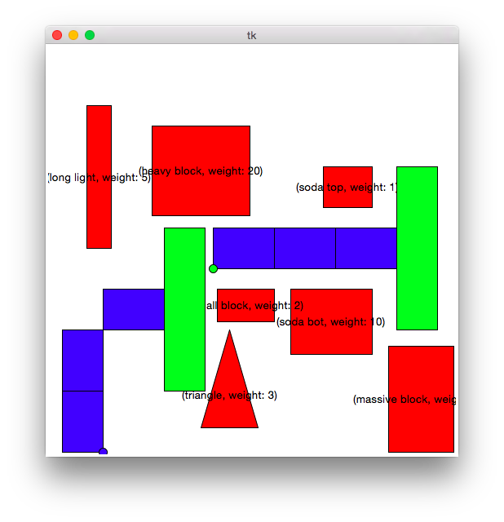
Cluttered with greedy path (150 iter, 200 trials, 40 interval)
algorithm | success rate | avg time | avg path length | avg cover score

Slide 9
Takeaway

Slide 10
Cluttered with greedy path (200 iter, 200 trials, 40 interval)
algorithm | success rate | avg fail time | avg success time | avg path length | avg cover score
RRT | 0 | 0.96 | 0 | 0 | 0
BiRRT | 0 | 4.80 | 0 | 0 | 0
TLP MCR | 0 | 4.91 | 0 | 0 | 0
Greedy Removal | 100 | 0 | 4.11 | 4656.24 | 16.3
Probabilistic Removal | 100 | 0 | 5.36 | 4927.45 | 20.09
Ignore Non-Permanent | 100 | 0 | 1.40 | 5187.00 | 55.08
Repeat Prob Removal | 100 | 0 | 52.81 | 4617.88 | 15.96
Search Then Greedy Removal | 100 | 0 | 8.66 | 4603.05 | 16.25
HPN Like Removal | 100 | 0 | 26.71 | 4775.18 | 17.10

Slide 11
Takeaway

Slide 12

Cluttered world with top light path (150 iter, 200 trials, 40 interval)
algorithm | success rate | avg time | avg path length | avg cover score
MCR
RRT
BiRRT
TLP MCR
Greedy Removal
Probabilistic Removal
Ignore non permanent
Repeated probabilistic removal
Search then greedy removal

Slide 13
Takeaway

Slide 14
Cluttered world with top light path (200 iter, 200 trials, 40 interval)
algorithm | success rate | avg fail time | avg success time | avg path length | avg cover score
RRT | 0 | 0.93 | 0 | 0 | 0
BiRRT | 0 | 4.58 | 0 | 0 | 0
TLP MCR | 0 | 4.67 | 0 | 0 | 0
Greedy Removal | 100 | 0 | 4.10 | 5189.46 | 25.15
Probabilistic Removal | 100 | 0 | 5.45 | 5412.72 | 24.275
Ignore Non-Permanent | 100 | 0 | 1.34 | 5222.05 | 59.07
Repeat Prob Removal | 100 | 0 | 50.29 | 5860.71 | 14.75
Search Then Greedy Removal | 100 | 0 | 9.04 | 5414.53 | 25.13
HPN Like Removal | 100 | 0 | 26.45 | 5279.53 | 26.88

Slide 15
Takeaway

Slide 16
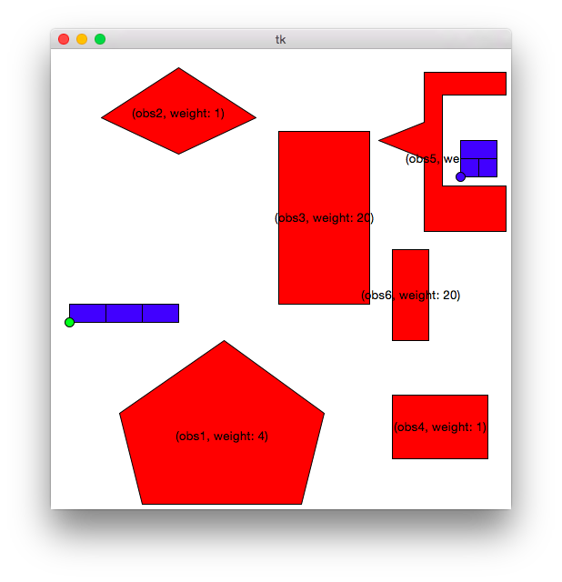
World where expect search to Have an impact(200 iter, 200 trials, 40 interval)
algorithm | success rate | avg fail time | avg success time | avg path length | avg cover score
RRT | 0 | 2.92 | 0 | 0 | 0
BiRRT | 0 | 3.48 | 0 | 0 | 0
TLP MCR | 0 | 3.43 | 0 | 0 | 0
Greedy Removal | 100 | 0 | 1.97 | 7175.50 | 19.75
Probabilistic Removal | 100 | 0 | 2.40 | 7454.49 | 20.33
Ignore Non-Permanent | 100 | 0 | 1.05 | 6614.65 | 26.52
Repeat Prob Removal | 100 | 0 | 22.99 | 8620.46 | 8.45
Search Then Greedy Removal | 100 | 0 | 2.57 | 7354.78 | 20.09
HPN Like Removal | 100 | 0 | 5.46 | 7451.74 | 19.37

